Slide 1
ThreatSense: Intelligent Threat Detection
By
Sai Charan Annam,
Vani Janagani,
Pavan Kalyan Pathi.

Slide 2
INTRODUCTION
Growing volume and complexity of cyber threats.
Modern networks generate huge volumes of security events every day.
Need for efficient log analysis and alert reduction.
ML provides intelligent approach to detect attack patterns.
Using data sets in ML can identify new and unknown threats.

Slide 3
WHAT IS THREAT DETECTION
The process of identifying malicious or suspicious activity that can harm computer’s network system or data is known as threat detection.
Types of threats:
Network intrusions
Malware
Phishing
Insider threats

Slide 4
WHY DETECTING THREATS ARE CHALLENGING TODAY?
Rapidly evolving threat landscape
Massive data volume
Encrypted and obfuscated data
False positives
Shortage of skilled analysts

Slide 5
WHAT ARE DATASETS
Collection of structured and unstructured data.
Multiple rows and columns.
Includes network traffic logs, attack signatures or patterns, and system event records.
External data sets are used to train the ML.

Slide 6
PROBLEM STATEMENT
High-dimensional and redundant data in security event logs.
SOC receive massive amounts of log data every day.
Difficulty in identifying true positive vs. false positives.
Lack of scalability and accuracy.
Analysts spends immense amount of time and money to investigate suspicious alerts.

Slide 7
PROPOSED SYSTEM OVERVIEW
Converts large scale of security events into small individual events.
Uses external data sets to train the ML.
Learns normal and threat patterns using AI based methods.
This innovative approach reduces dimensionality space, overcoming a common challenge in traditional data mining techniques related to log analysis.

Slide 8
ADVANTAGES
SIEM analysts can spend very less efforts and time to differentiate between true and false security alerts.
Reduction of false positives alerts.
Efficient alert management.
Real world applicability.

Slide 9
DATASETS AND DATA PROCESSING
Datasets used
NSL-KDD
CICIDS2017
Data preprocessing involves
TF-IDE (Term Frequency-Inverse Document Frequency): Evaluates word importance in documents
Event Vectorization: Represents events or data points as numerical vectors.

Slide 10
ML APPROACHES
CNN: Deep learning for image analysis.
SVM: Effective for classification and regression with high-dimensional data.
RF: Ensemble learning for improved accuracy and handling complex datasets.
NNP: Instance-based learning for simple and small dataset classification.
KNN: Classifies based on nearest neighbours, suitable for various tasks.
Decision Tree: Interpretable model for classification and regression tasks.

Slide 11
METHODOLOGY
Data Collection
Preprocessing (Feature extraction + base point generation)
Model Training
White-box testing
Evaluation & Comparison

Slide 12
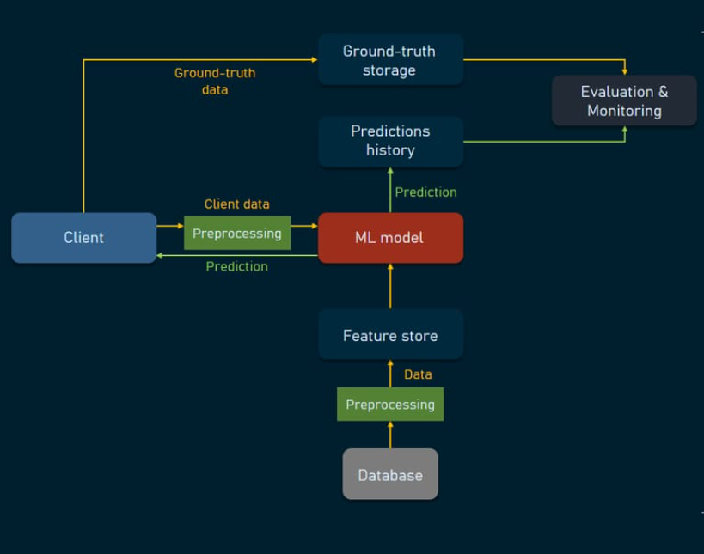
SYSTEM ARCHITECTURE

Slide 13
EVALUATION METRICS
Accuracy
Recall
F1-score
Precision

Slide 14
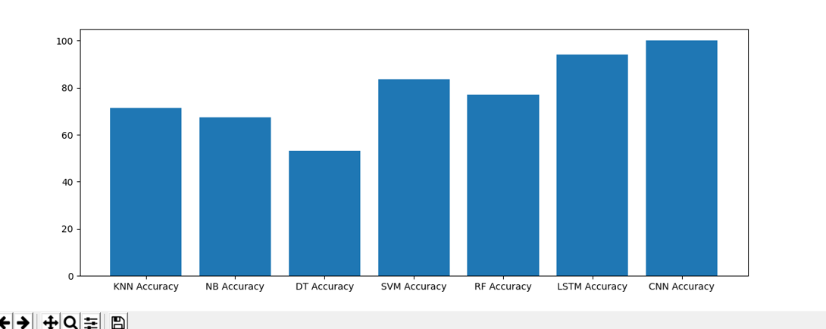
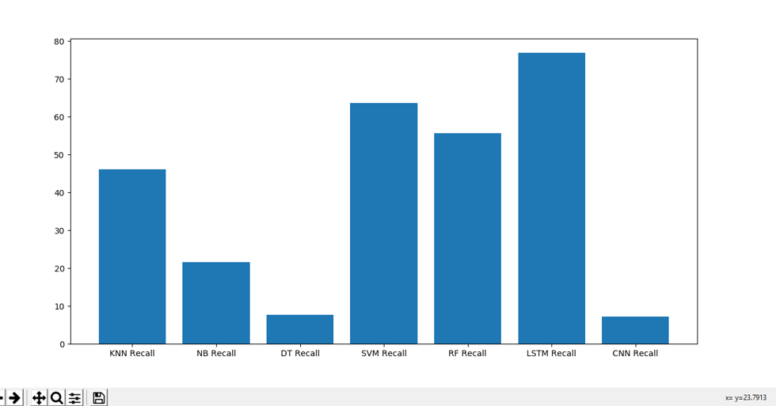
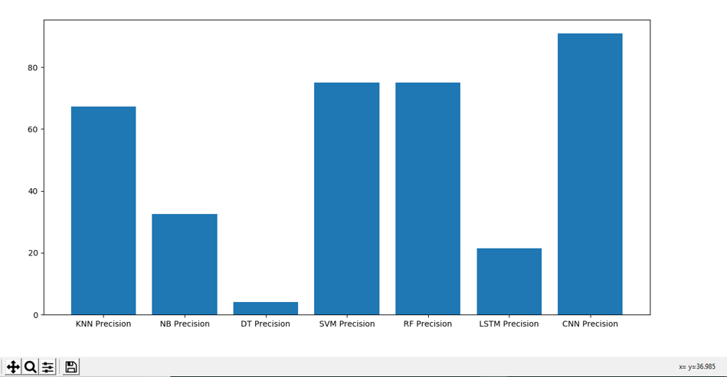
GRAPHS

Slide 15
RESULTS
 | Accuracy | Precision | Recall | FMeasure
KNN | 71.3 | 59.3 | 37.3 | 42.9
Random Forest | 77.1 | 61.9 | 41.0 | 48.6
SVM | 83.5 | 66.4 | 52.9 | 58.8
Naive Bayes | 67.3 | 28.3 | 17.3 | 20.7
Decision Tree | 53.2 | 3.5 | 6.6 | 4.6
CNN | 99.4 | 100.0 | 5.4 | 10.9

Slide 16
FUTURE WORKS
Integrate advanced deep-learning models such as Transformers for better long-term threat pattern analysis.
Implementing the best algorithm to make the prediction more accurate and faster.
Apply semi-supervised and self-supervised learning to reduce dependence on labeled datasets.
Incorporate external threat-intelligence feeds for more accurate and context-aware detection.
Develop a full AI-SIEM dashboard with automated alert prioritization.

Slide 17
CONCLUSION
The ML-based threat detection system improves accuracy compared to traditional security methods.
Multiple ML models (CNN, SVM, RF, KNN, Decision Tree, NNP) were tested for performance comparison.
Achieves reduced false positives and faster classification of security alerts.
The ML-based system significantly improves SOC efficiency by reducing false alerts and enabling faster threat identification.
In the future, this approach can be expanded using deep learning models and real-time log streaming, making the system even smarter and capable of detecting new and evolving cyber threats.
Overall, the project proves that machine learning will play a major role in next-generation cybersecurity automation and intelligence.

Slide 18
MY CONTRIBUTION
I have contributed to the design of the comprehensive architecture for the ThreatSense. Additionally, I developed a modular code structure for managing datasets, preprocessing information, and integrating models.
I had major contribution in completing the project documentation.
I also developed robust code for all machine learning algorithms to ensure accurate measurements of Accuracy, Recall, F1-Score, and Precision, and established a framework for generating appropriate graphical representations.
Furthermore, I collaborated with my team to design a user-friendly Tkinter graphical user interface, incorporating interactive elements and real-time updates within the interface.

